Slide 1
SOFTWARE PROJECT
LAB-1

Slide 2
Project name :
Equation Solver & Plotter
Presented by:
Amit Kumar Roy
Roll: 1314
Supervised by:
Kishan Kumar Ganguly
Assistant Professor
IIT, DU

Slide 3
Overview
Mainly this project will solve two types of problems
Linear Equation
Polynomial Equation

Slide 4


Tool used
Tools used
Language: C++
Github link: https://github.com/AmitRoy01/SPL-1

Slide 5
Project Description
Generally this program will take linear and polynomial equation as input.
Shows step by step solution process .
Finally shows output with plotting graph.

Slide 6
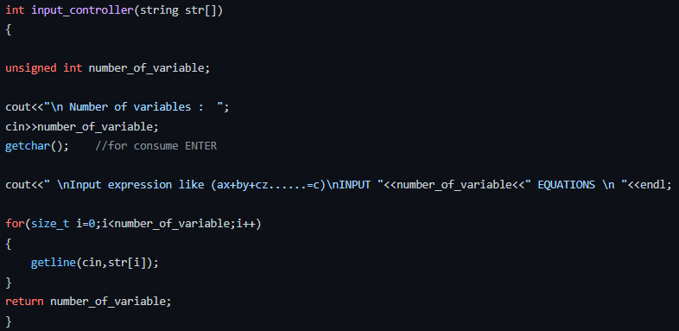
Flashback of Equation to Solution
Here I take equation as a line of string.

Slide 7
Flashback of Equation to Solution
Then tokenizing and parsing the expression , we can extract variables ,coefficient , operator,power,fractional point value.
After that I solve this equations using matrix method.
Lets see how the method do solve,,,,

Slide 8
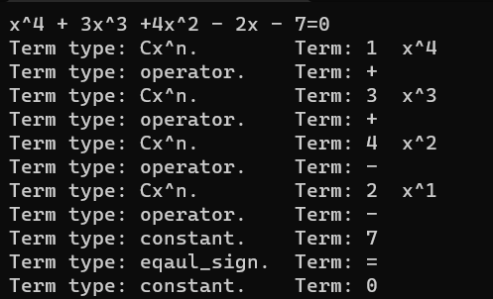
Output After tokenizing

Slide 9
Linear Equation solve
Input linear equation
Create Matrix
Find determinant of matrix
(row reduction method)
Det = 0
yes
Infinite / No solution
no
Unique Solution
(Cramer’s rule)

Slide 10
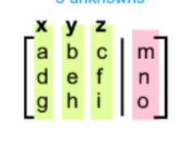
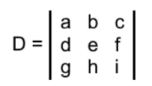
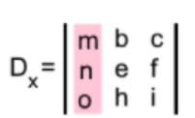
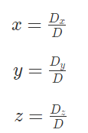
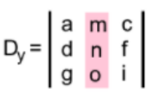
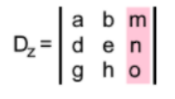
Coefficient Column Vector
Matrix

Slide 11
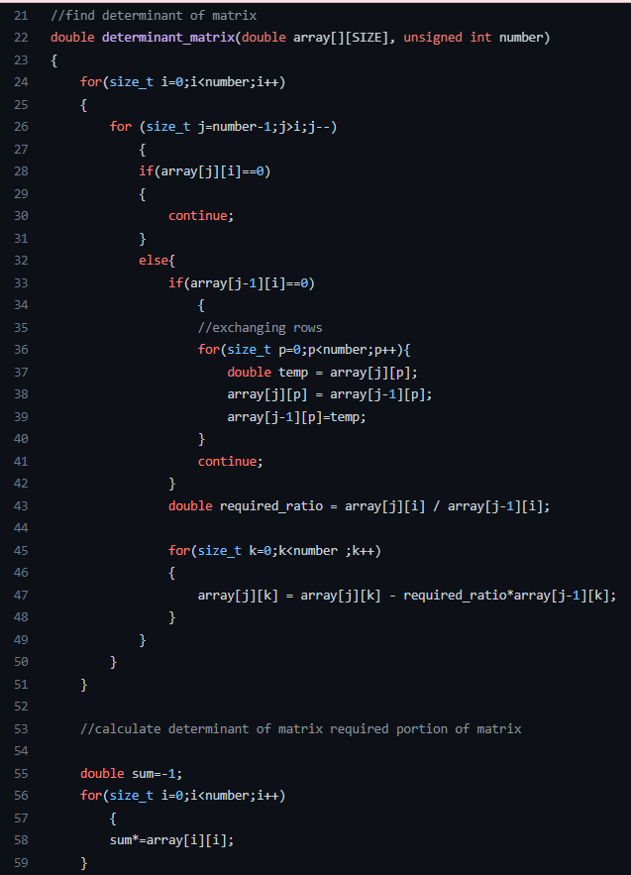
Find Determinant

Slide 12
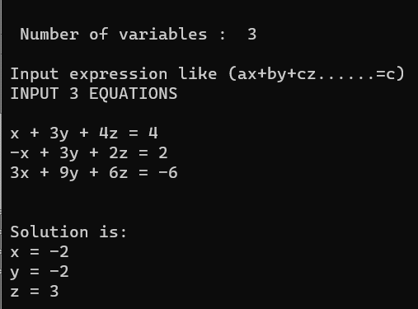
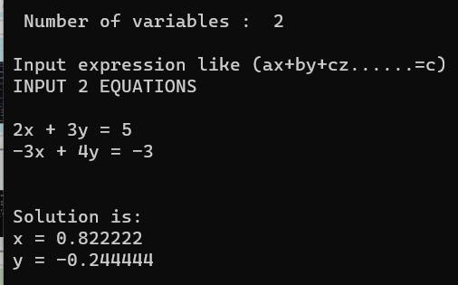
Sample Input -Output
3 variable
2 variable

Slide 13

What are the challenges?
Separate variable and number
Create matrix from equations
Implementing tokenizer,parser,matrix algorithm

Slide 14
Next Target
Show step by step solve of linear equation
Solve Polynomial Equation
Show step by step solve of polynomial equation
Show Solution through Graph Plotting

Slide 15
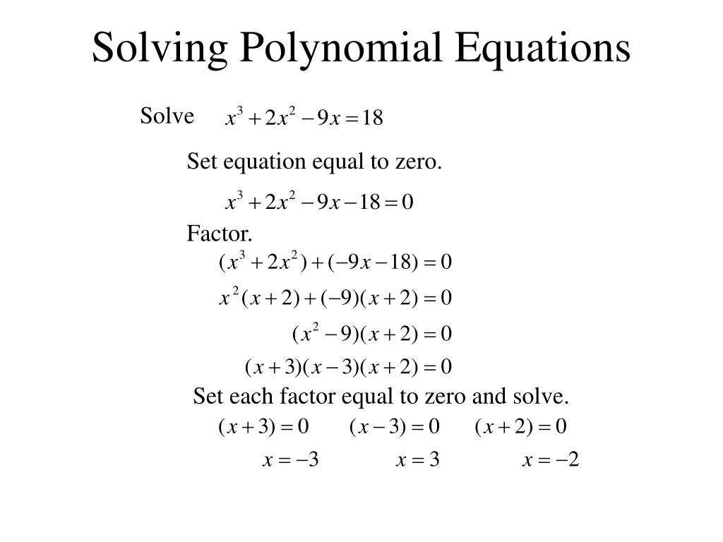

Slide 16
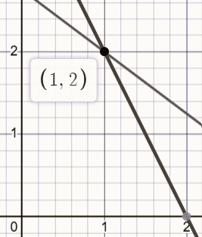
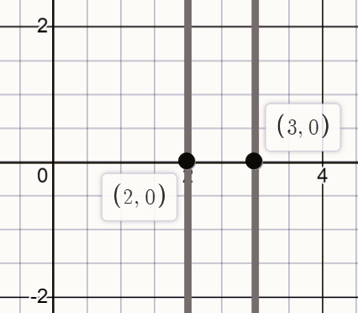
sample Graph Plotting

Slide 17
Thank you!

